Slide 1

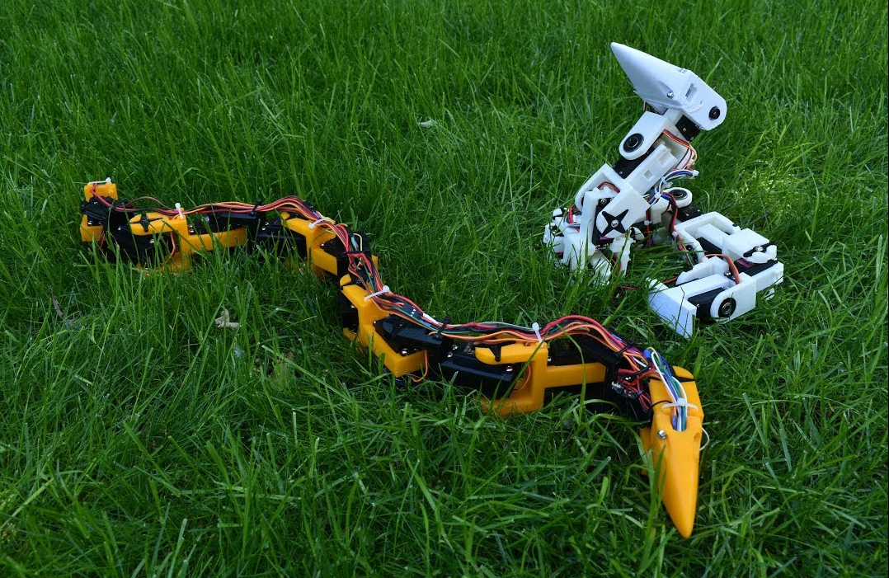
21AIE445 – APPLICATION OF ROBOTICS PROJECT PRESENTATION
SNAKE ROBOT
TEAM 16 - INFINITY
GUIDED BY
Nippun Kumar AA
APOORVA M – AIE19007
TANUJ M – AIE19041
AISHWARYA V – AIE19068

Slide 2
ABSTRACT
This project is to design a snake-like robot that can provide the locomotion as the real snake. The shape and sizes of the snake-like robot is depend on its own application, different application may require different sizes and shapes. In order to make the snake-like robot function and move like a real biological snake, snake-like robot may construct of multiple joints which enable the snake-like robot to have multiple degree of freedom, which give it the ability to flex, reach and approach a huge volume in its workspace with infinite number of configurations. This mobility can enable the robot to move around in more complex environments. So, the application for this snake-like robot could be very useful in hard to reach places or hazardous environments.

Slide 3
INTRODUCTION
Bio inspired robots are those that imitate features of fauna that we see around .
By borrowing movement strategies from nature robots could gain new functionality
Although big industrial robots in vehicle factories, for instance, remain anchored in place, other robots will be more useful if they can move through the world, performing different tasks and coordinating their behavior.
Developing such robots that can bounce and land securely without risking harm to the mechanism, or developing body and facial expression of satisfaction and excitement are simple tasks for human and fauna to do however greatly complex to build
Recent technological developments have allowed one to easily animate graphically the appearance and conduct of biological creatures
The overall idea is looking to nature to see how things can potentially be done differently, how we can improve our automated systems

Slide 4
LITERATURE SURVEY SUMMARY
Insights on Different Designs of Snake robots have been gained.
Aspect that is being focused affects the design of the robot .
Some of the aspects are
- Focus on the natural locomotion replication of the snake
-Tweaking the movement of the bot depending of the environment in which it's being used
- Focus of achieving various kinds configuration of the robot

Slide 5
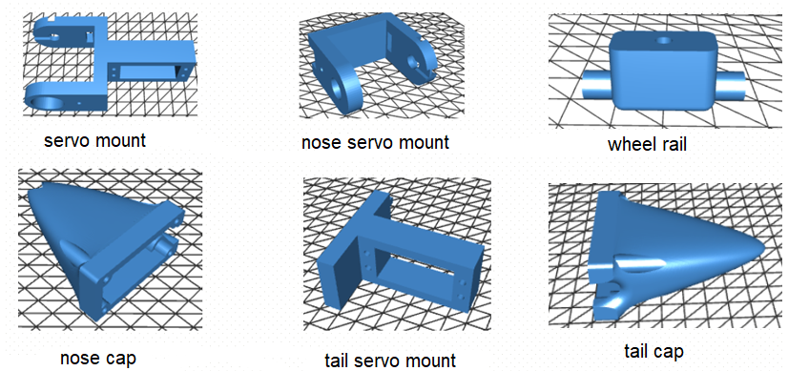
3D PRINTED PARTS

Slide 6
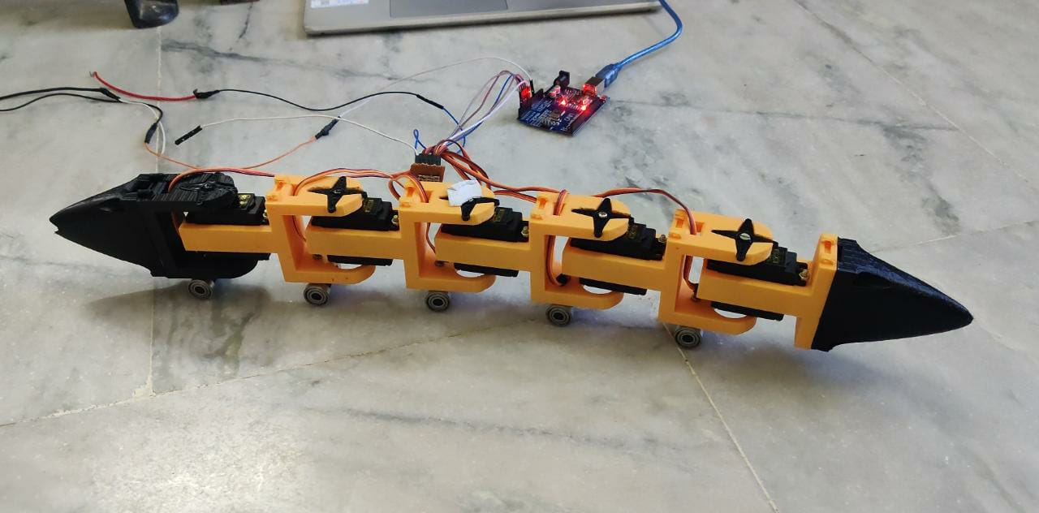
ASSEMBLED SNAKE BOT

Slide 7
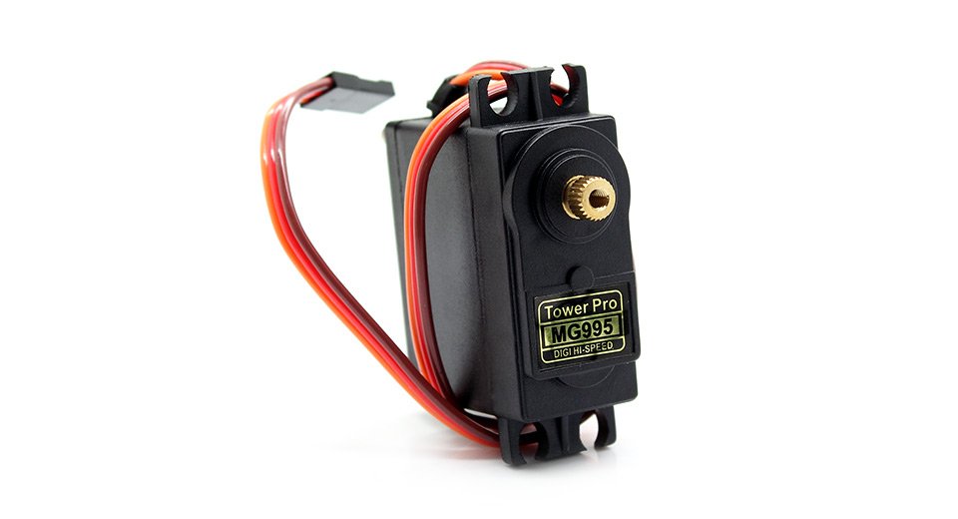
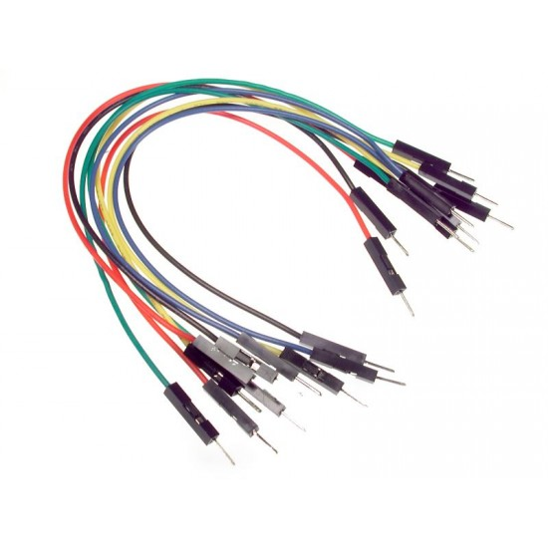
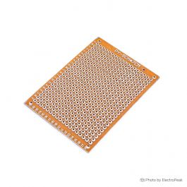
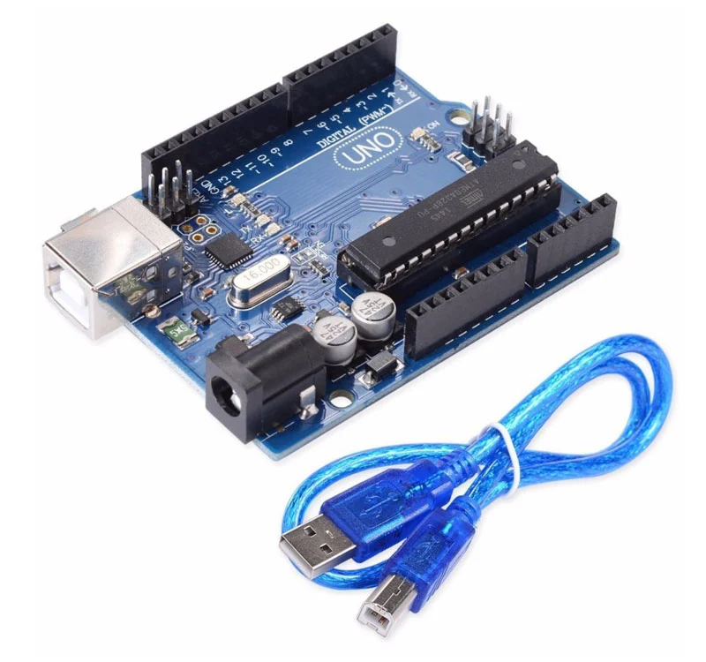
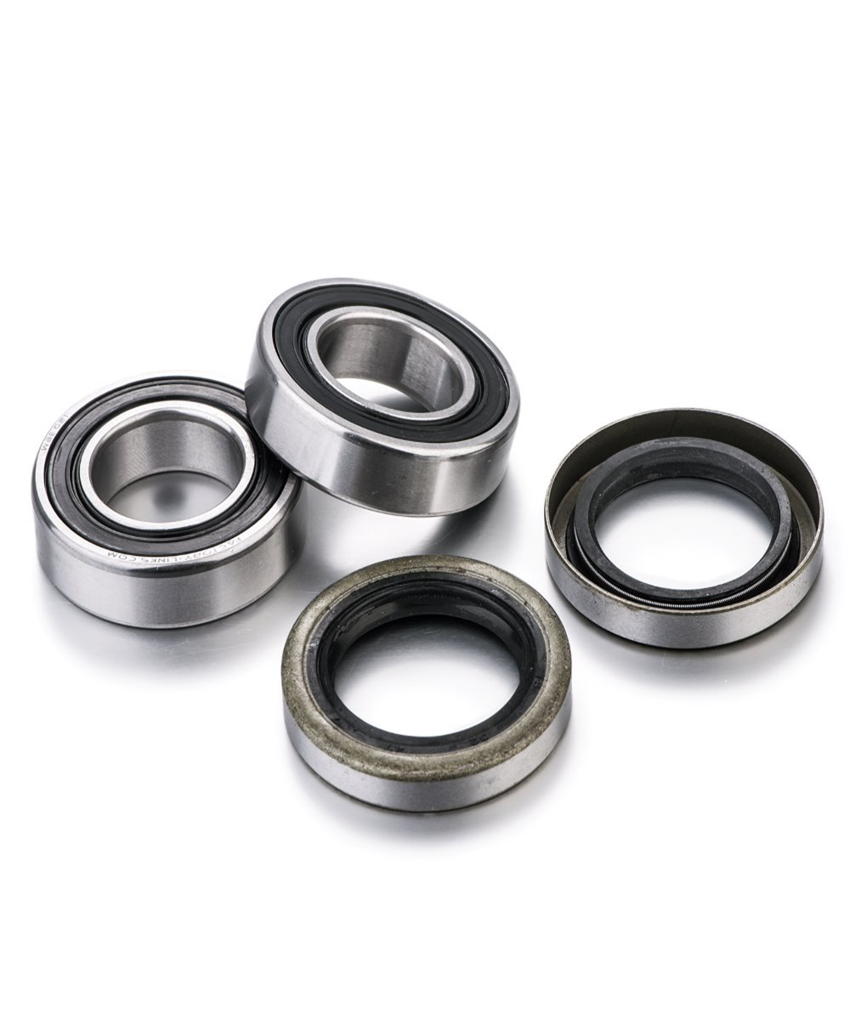
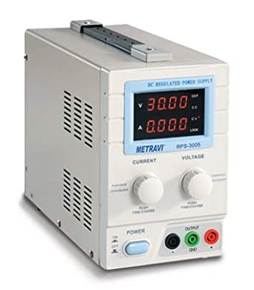
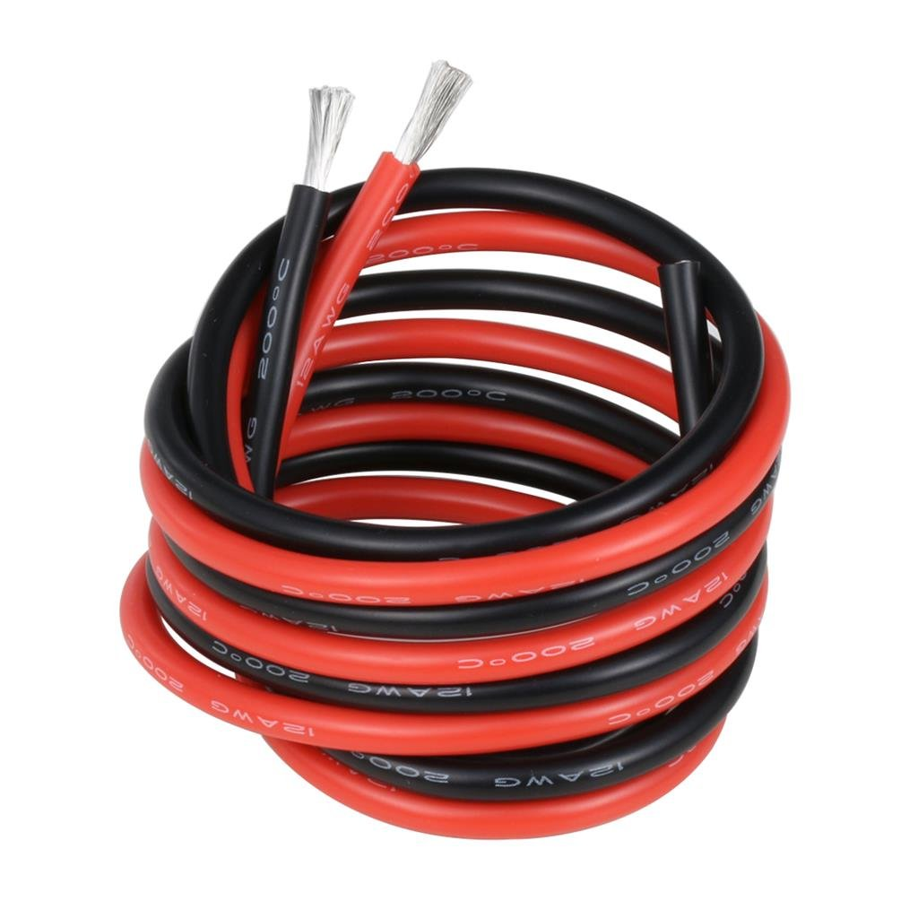
REQUIRED ELECTRICAL COMPONENTS
MG995 Servo Motor
Qty: 5
Jumper Wires
Qty: M-F(7)
Dot Board (4x6)
Arduino Uno
Wheel Bearing
Qty :10
RPS
1.2mm Gauge Wire

Slide 8
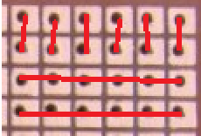
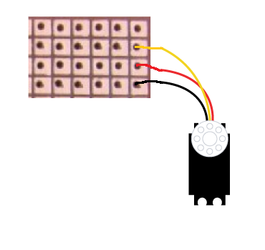
DOT BOARD SETUP
Signal pin
+5v
Ground
Connection
Dot Board Soldering

Slide 9
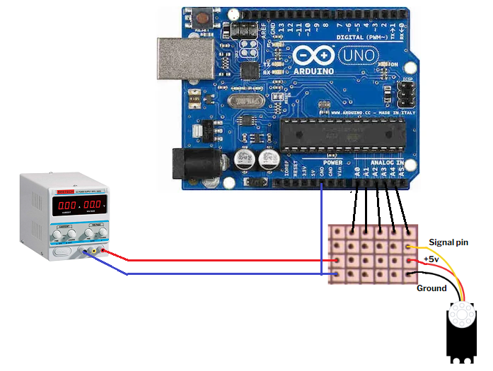
CIRCUIT CONNECTION
The motors are connected in parallel using dot board.
The terminal wires of the motors connected in parallel are
connected to the RPS.
The signal pins of the motors from the dot board
are connected to the Analog pins(A0-A4) port in
Arduino uno board.
Arduino is connected to laptop through the adapter
Ground port of arduino should be connected to RPS ground

Slide 10
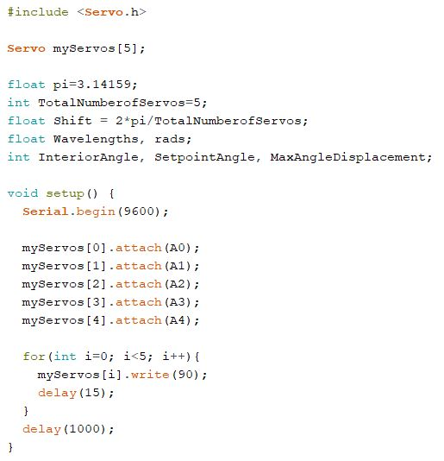
CODE SNIPPETS

Slide 11
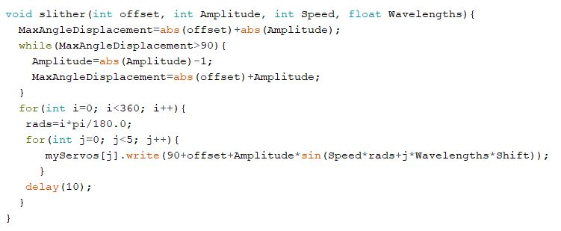

Slide 12
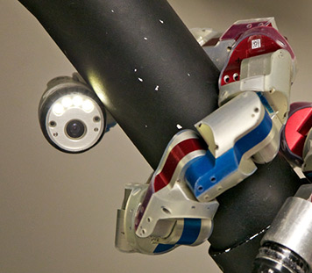
APPLICATIONS
Surveillance
Military
Pipe examination.
Disaster management
Underwater exploration

Slide 13
CONCLUSION
Various 3D designs for building Bio inspired robots have been explored.
Gained insights on the applications of Snake robots
3D printed the parts
Snake robot using 5 Servo motors has been implemented.
Slithering and Ushape motions have been explored.

Slide 14
FUTURE SCOPE
Robot can be expanded and other types of motion can be explored.
Applications such as surveillance can be added.
Soft robot can be developed using a similar mechanism.

Slide 15
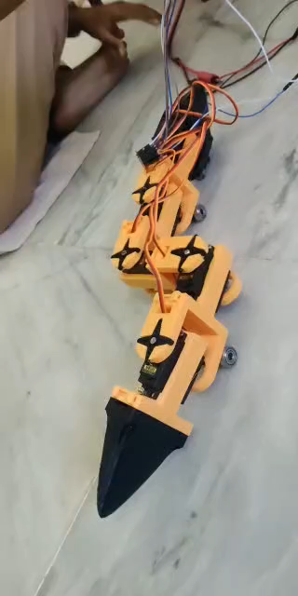
DEMO

Slide 16
THANK YOU

